Slide 1
NLP / VECTOR SEARCH / RAG / EVALUATION
Intelligent Support Ticket
Classification with RAG
Hybrid retrieval, weak-label classification, traditional baseline,
and response generation evaluation
NLP
Vector Search
Transformers
Evaluation
PREPARED FOR PROJECT PRESENTATION
01 / 25

Slide 2
02 / AGENDA
Presentation Roadmap
From problem definition to evaluation and recommended architecture
01
02
03
Problem & Objective
Dataset & EDA
Modeling Workflow
Why support ticket automation matters
Data quality, categories, and preprocessing
TF-IDF baseline, BM25, FAISS, and RAG
04
05
06
Evaluation Results
Recommendations
Deployment
Classification, retrieval, and response metrics
Final architecture and next steps
Production stack and live preview
Intelligent Support Ticket Classification with RAG
02 / 25

Slide 3
03 / OBJECTIVE
Project Objective
Build an intelligent NLP system for support ticket classification and response assistance
01
02
03
Business Goal
ML Goal
Deliverables
Reduce manual effort in support operations by automatically categorizing incoming tickets and proposing relevant response context.
Compare a traditional supervised classifier against a retrieval-based RAG workflow, then evaluate classification, retrieval, and response quality.
• Cleaned corpus
• EDA analysis
• Baseline model
• Hybrid retriever
• RAG classifier
• Evaluation report
• Final PPT deck
Intelligent Support Ticket Classification with RAG
03 / 25

Slide 4
04 / PROBLEM
Problem Statement
Customer support teams face repetitive and high-volume text handling tasks
High ticket volume increases response and routing time.
1
TARGET OUTCOME
Manual categorization can be inconsistent across agents.
A system that classifies each ticket, retrieves similar historical examples, and generates a support-oriented draft response for agent review.
2
Many tickets repeat similar issues and responses.
3
Support teams need faster access to similar historical cases.
4
›
›
›
Ticket
Classify
Retrieve
Respond
Intelligent Support Ticket Classification with RAG
04 / 25

Slide 5
05 / APPROACH
Proposed Solution Overview
A hybrid system combining supervised classification with retrieval-augmented generation
01
02
03
04
05
Customer Ticket
Preprocessing
Classification
Retrieval
Generation
Raw customer issue text
Clean and normalize text
Predict ticket category
Find similar old tickets
Draft support response
CORE IDEA
Use TF-IDF + Logistic Regression for reliable ticket classification, and use BM25 + FAISS + Qwen for similar-case retrieval and context-aware response generation.
Intelligent Support Ticket Classification with RAG
05 / 25

Slide 6
06 / DATA
Dataset Overview
Large-scale customer support tweet dataset with paired customer messages and support responses
945,278
2
0
1,838
Original Rows
Columns
Missing Values
Duplicates
loaded records
input / output
input / output
exact duplicate rows
FIELD MEANING
DATASET NOTE
input = customer ticket / issue message
output = historical support agent response
The dataset did not provide official category labels, so categories were created using reproducible weak-labeling rules.
Source: MohammadOthman/mo-customer-support-tweets-945k
Intelligent Support Ticket Classification with RAG
06 / 25

Slide 7
07 / EDA
Exploratory Data Analysis
EDA was used before and after cleaning to understand quality, scale, and text characteristics
Raw data checks
Text length insight
Why it matters
• Shape and columns
• Missing values
• Duplicate records
• Text length distributions
• Frequent terms and noise patterns
Average input length: ~97 characters
Average output length: ~100 characters
Tickets are short, conversational, and tweet-like.
EDA justified cleaning choices and helped identify that weak labeling was needed for classification.
Intelligent Support Ticket Classification with RAG
07 / 25

Slide 8
08 / PREPROCESS
Data Cleaning & Preprocessing
Transform noisy support text into a consistent model-ready representation
01
Lowercase
02
Remove URLs
03
HTML cleanup
Normalize case differences
Drop links and tracking noise
Remove tags and entities
04
Symbol cleanup
05
Normalize spaces
06
Duplicate handling
Reduce noisy punctuation
Ensure clean tokenization
Remove repeated rows
OPTIONAL
MinHash LSH near-duplicate removal can be disabled in large Kaggle runs to reduce CPU time while keeping exact duplicate removal.
Intelligent Support Ticket Classification with RAG
08 / 25

Slide 9
09 / LABELS
Weak Labeling: Ticket Category Creation
Categories were created from reproducible keyword rules because official labels were unavailable
CATEGORY
COUNT
SHARE
DESCRIPTION
general_support
456,611
50.3%
General requests and unclear cases
technical_app
170,888
18.8%
App, technical, bug, access issues
order_shipping
94,313
10.4%
Order, delivery, tracking, shipping
product_service
71,027
7.8%
Product/service questions or complaints
billing_payment
63,601
7.0%
Payment, card, charge, billing
refund_return
32,450
3.6%
Refund, return, cancellation
account_login
18,079
2.0%
Login, password, account access
Interpretation: classification results evaluate how well models learn these constructed labels, not original human-labeled categories.
Intelligent Support Ticket Classification with RAG
09 / 25

Slide 10
10 / SPLIT
Train / Test Split
All fitting, indexing, embedding generation, and retrieval were built on train data only
725,575
181,394
Category
Train Set
Test Set
Stratified By
80% of cleaned data
20% unseen data
same distribution
WHY STRATIFICATION MATTERS
Using stratify=df['category'] keeps the same category proportions in train and test, making evaluation fair for all support categories.
NO DATA LEAKAGE
The test set is not used when fitting TF-IDF, BM25, FAISS, embeddings, or retrieval indexes.
Intelligent Support Ticket Classification with RAG
10 / 25

Slide 11
11 / BASELINE
Traditional Classification Baseline
TF-IDF + Logistic Regression provides a fast supervised baseline for category prediction
→
→
→
Clean ticket text
TF-IDF Vectorizer
Logistic Regression
Predicted category
TF-IDF CONFIGURATION
CLASSIFIER CONFIGURATION
max_features = 80,000
ngram_range = (1, 2)
min_df = 2
sublinear_tf = True
LogisticRegression(
max_iter = 1000,
class_weight = 'balanced',
n_jobs = -1
)
Intelligent Support Ticket Classification with RAG
11 / 25

Slide 12
12 / RETRIEVAL
RAG Retrieval Architecture
Hybrid retrieval combines exact keyword search and semantic vector search
BM25
FAISS
Hybrid Score
Keyword-based retrieval
Vector-based semantic retrieval
Combined ranking
Best for exact words, product names, error codes, and repeated terms.
Best for similar meaning even when users use different wording.
FAISS_WEIGHT × semantic score
+ BM25_WEIGHT × keyword score
DOWNSTREAM USE
The top retrieved tickets become context for RAG classification and response generation.
Intelligent Support Ticket Classification with RAG
12 / 25

Slide 13
13 / LOGIC
RAG-Based Classification Logic
Classifies by retrieving similar tickets and voting by category
01
02
03
04
05
Query ticket
Hybrid retrieve Top-K
Collect retrieved categories
Weight by score + rank bonus
Highest category score wins
SCORING RULE
category_score += retrieval_score + (1 / rank)
Rewards both similarity and appearing near the top of the retrieved list.
Intelligent Support Ticket Classification with RAG
13 / 25

Slide 14
14 / RESULTS
Classification Results
Traditional supervised classification outperformed retrieval-based classification
MODEL COMPARISON
TF-IDF + LOGISTIC REGRESSION
TF-IDF + Logistic Regression
Hybrid RAG Classifier
0.9747
Accuracy
0.975
0.704
Weighted F1: 0.9746 • Best classifier
Precision
0.975
0.702
Recall
0.975
HYBRID RAG CLASSIFIER
0.704
0.7040
F1
0.975
0.699
Weighted F1: 0.6989 • Retrieval-based
Intelligent Support Ticket Classification with RAG
14 / 25

Slide 15
15 / INSIGHT
Why TF-IDF Outperformed RAG for Classification
The labels are strongly keyword-driven and the baseline is directly supervised
01
02
03
Category keywords are explicit
Supervised learning fits labels
RAG depends on retrieval purity
Words like login, password, refund, shipping, payment, and order strongly indicate category.
Logistic Regression directly learns input → category from labeled examples.
If the Top-K retrieved tickets contain mixed categories, voting becomes noisy.
Intelligent Support Ticket Classification with RAG
15 / 25

Slide 16
16 / RETRIEVAL EVAL
Retrieval Evaluation
The retriever is useful, but not clean enough to replace supervised classification
0.636
0.906
0.744
Precision@5
Hit@5
MRR@5
Top-5 category purity
At least one correct result
First correct result rank
INTERPRETATION
The system usually finds at least one correct-category ticket, but the retrieved list still includes irrelevant tickets.
Intelligent Support Ticket Classification with RAG
16 / 25

Slide 17
17 / GENERATION
Response Generation Evaluation
Automatic generation metrics compare generated responses against historical reference replies
TF-IDF Nearest Response
Hybrid RAG + Qwen
ROUGE-1
0.1329
0.1251
ROUGE-2
0.0152
0.0204
ROUGE-L
0.0995
0.0914
BLEU
0.9881
0.5704
NOTE
ROUGE / BLEU can understate response quality because valid support answers may use different wording from the dataset reference.
Intelligent Support Ticket Classification with RAG
17 / 25

Slide 18
18 / SYNTHESIS
Evaluation Interpretation
The project shows that the best architecture should combine both approaches
01
02
03
Classification
Retrieval
Generation
TF-IDF + Logistic Regression is the strongest category predictor and should be used for the primary routing decision.
Hybrid BM25 + FAISS has strong Hit@5, making it valuable for surfacing relevant historical examples.
RAG generation should be improved with better prompting, reranking, and semantic / human evaluation.
Intelligent Support Ticket Classification with RAG
18 / 25

Slide 19
19 / ARCHITECTURE
Final Recommended Architecture
Use each model where it performs best
01
02
03
04
05
Customer Ticket
TF-IDF Category Prediction
Category-Filtered Retrieval
BM25 + FAISS Similar Tickets
Qwen RAG Response Draft
CONSULTANT RECOMMENDATION
Do not use RAG alone as the classifier.
Use TF-IDF for robust category routing, then use RAG for evidence retrieval, explainability, and response generation.
Intelligent Support Ticket Classification with RAG
19 / 25

Slide 20
20 / NEXT STEPS
Next-Step Recommendations
Improvements to raise quality and make the system more production-ready
RETRIEVAL
GENERATION
DATA
Retrieval Improvements
Generation Improvements
Data Improvements
• Tune FAISS / BM25 weights
• Try Top-K = 3, 5, 8, 10
• Increase candidate pool
• Add a cross-encoder reranker
• Filter retrieval by predicted category
• Improve prompt template
• Use retrieved responses as examples
• Add BERTScore or embedding similarity
• Add human evaluation on 20–50 samples
• Reduce hallucination with stricter context rules
• Replace weak labels with human labels
• Add priority / urgency labels
• Track real agent feedback
• Build a real validation set
• Monitor class drift
Intelligent Support Ticket Classification with RAG
20 / 25

Slide 21
21 / LIMITATIONS
Limitations & Risk Notes
Professional interpretation of current project results
R-01
Categories are weak-labeled from keywords, not official human annotations.
R-02
The very high TF-IDF accuracy may partly reflect the keyword-based label construction.
R-03
Retrieval relevance was approximated using category match due to missing human relevance labels.
R-04
ROUGE / BLEU are limited for support responses because correct answers can be phrased differently.
R-05
The generator was evaluated on a small sample because large language model inference is expensive.
Intelligent Support Ticket Classification with RAG
21 / 25

Slide 22
22 / CONCLUSION
Project Conclusion
The completed notebook demonstrates a full end-to-end ML / NLP evaluation workflow
MAIN FINDING
TF-IDF + Logistic Regression is the best classification model for this dataset.
97.47%
Accuracy • F1 = 0.9746
RAG VALUE
BEST FINAL DESIGN
Hybrid RAG is still valuable — it retrieves supporting historical tickets and enables context-aware response drafting.
Use supervised classification for routing, then use RAG for retrieval, explainability, and response generation.
Intelligent Support Ticket Classification with RAG
22 / 25

Slide 23
23 / ARTIFACTS
Source Files & Generated Artifacts
Key files produced by the notebook run
NOTEBOOK ARTIFACTS
EVALUATION OUTPUTS
cleaned_labeled_dataset.csv
traditional_classification_metrics.json
train_embeddings.npy
retrieval_metrics.json
test_embeddings.npy
rag_classification_metrics.json
faiss_index.index
rag_generation_metrics.json
traditional_tfidf_logreg_classifier.joblib
final_run_summary.json
tfidf_nearest_response_model.joblib
plots and comparison charts
Intelligent Support Ticket Classification with RAG
23 / 25

Slide 24
24 / DEPLOYMENT
Deployment
A modern full-stack deployment with React + Next.js frontend and FastAPI backend serving the ML pipeline
FRONTEND
FRAMEWORK
BACKEND
React
Next.js
FastAPI
React powers the interactive UI components for the support agent dashboard, ticket submission forms, and live response previews — delivering a fast, component-based user experience.
Next.js provides the application shell with server-side rendering, routing, and optimized builds — ensuring fast page loads, SEO-friendly pages, and seamless integration with the React frontend.
FastAPI exposes the trained TF-IDF classifier, hybrid BM25 + FAISS retriever, and Qwen RAG response generator as REST endpoints — offering high-performance async inference with automatic OpenAPI docs.
Intelligent Support Ticket Classification with RAG
24 / 25

Slide 25
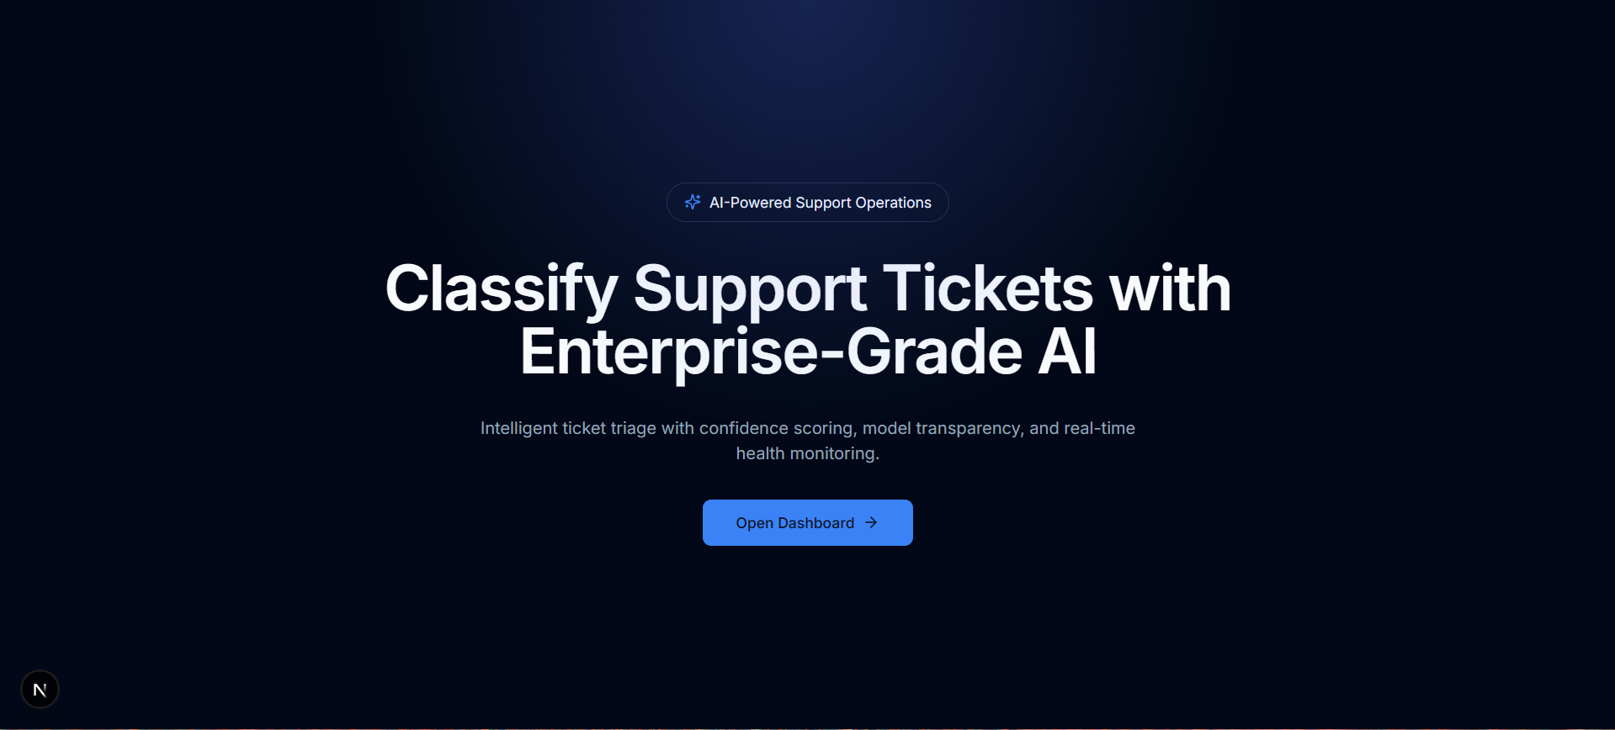
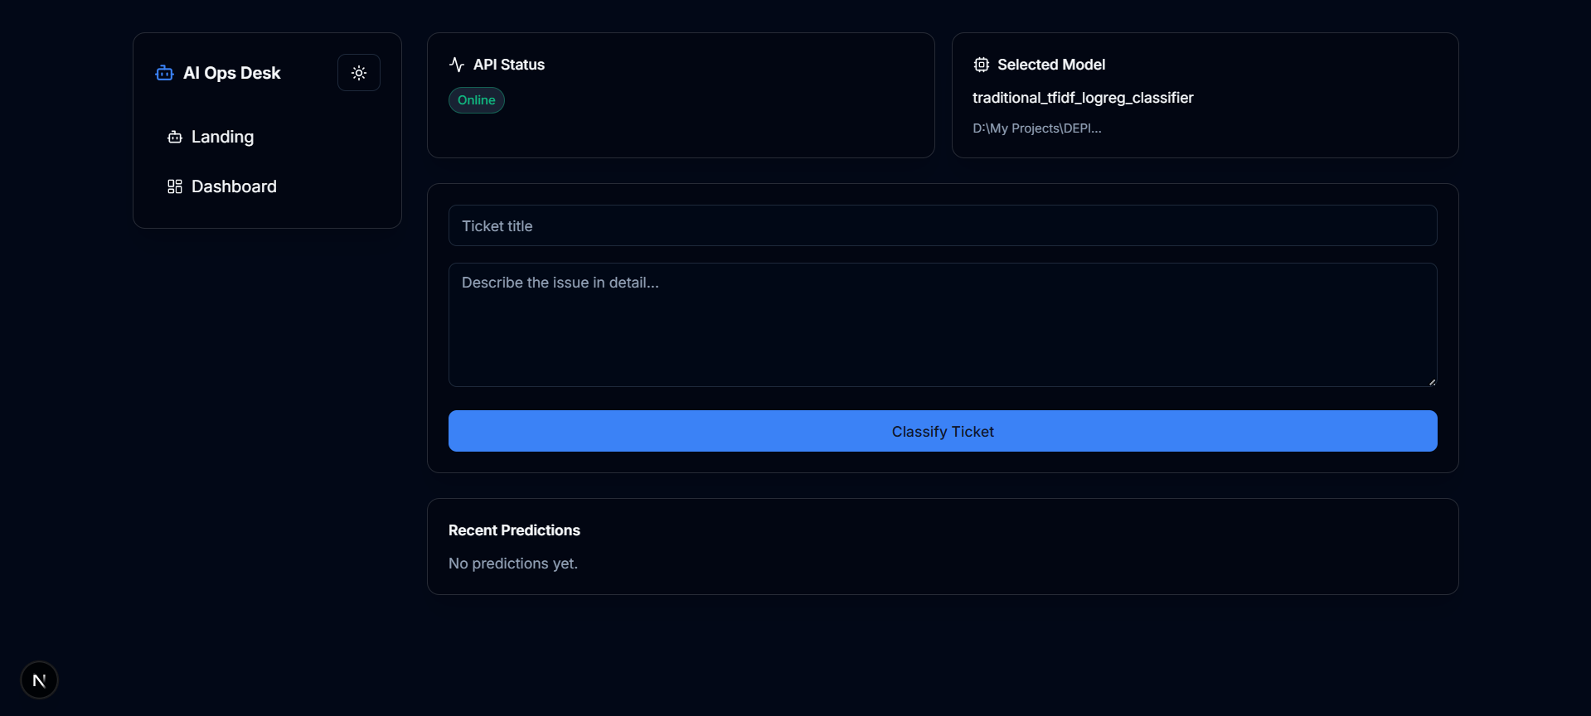
25 / PREVIEW
Deployment Preview
Live screens from the deployed app — landing page (React + Next.js) and the FastAPI-backed classification dashboard
LANDING PAGE
DASHBOARD
Intelligent Support Ticket Classification with RAG
25 / 25

